Slide 1

Cyclistic Bike Sharing – A Data Analytics Case Study
By Aurin Bose

Slide 2
Table of Contents
Introduction
Project Overview and Goals
Data and Analysis
Recommendations
Questions

Slide 3
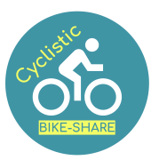
Introduction
What is this about? : A Data Analysis Case Study for Cyclistic Bike Share.
Objective : How do annual members and casual riders use Cyclistic bikes differently?

Slide 4
Project Overview and Goals
About Cyclistic : Launched in 2016; Fleet of 5824 bikes; Network of 692 stations across Chicago
Goals : Convert Casual Riders to Annual Members
Method : Data Analysis of 12 months of Trip Data

Slide 5
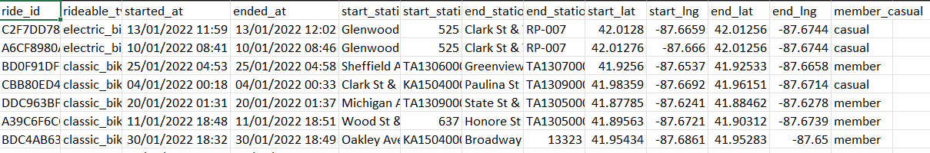
Data and Analysis
Data obtained from Divvy case study "'Sophisticated, Clear, and Polished’: Divvy and Data Visualization" written by Kevin Hartman (found here: https://artscience.blog/home/divvy-dataviz-case-study)
Preview of Data in CSV format

Slide 6
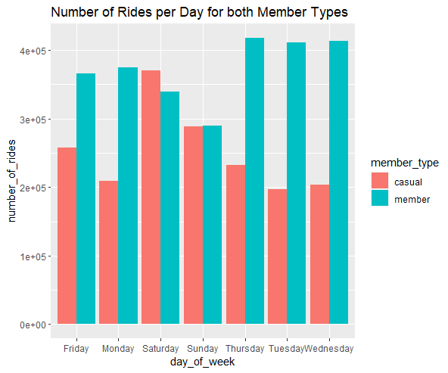
Number of Rides per Day
Casual riders ride more on weekends compared to annual members

Slide 7
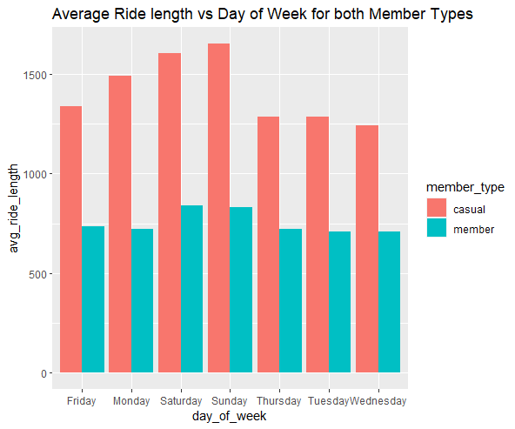
Average Ride Length per Day
Casual riders ride for longer than annual members

Slide 8
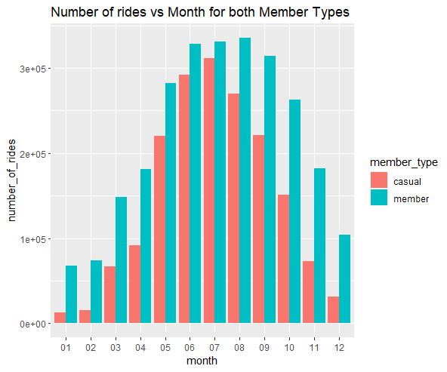
Number of Rides per Month
Both member types take more rides in Summer months

Slide 9
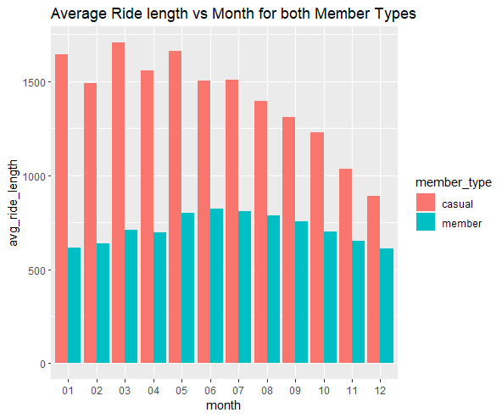
Average Ride Length per Month
Casual riders ride for longer at the start of the year.

Slide 10
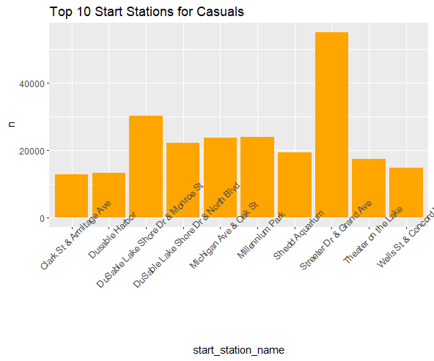
Favorite Start Station (Casual Riders)
Streeter Dr & Grand Ave is where most Casual riders start rides

Slide 11
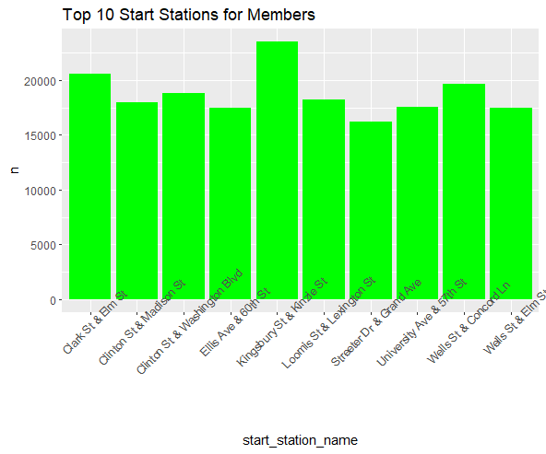
Favorite Start Station (Annual Members)
No clear preference but Kingsbury St & Kinzie St most popular

Slide 12
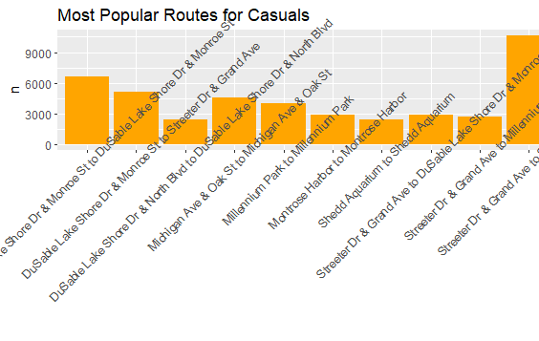
Favorite Route (Casual Riders)
Casuals mostly ride from Streeter Dr & Grand Ave and back

Slide 13
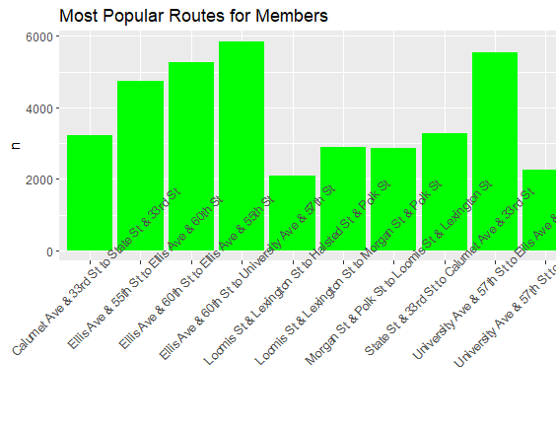
Favorite Route (Annual Members)
Ellis Ave & 60th St to University Ave & 57th St the most common route

Slide 14
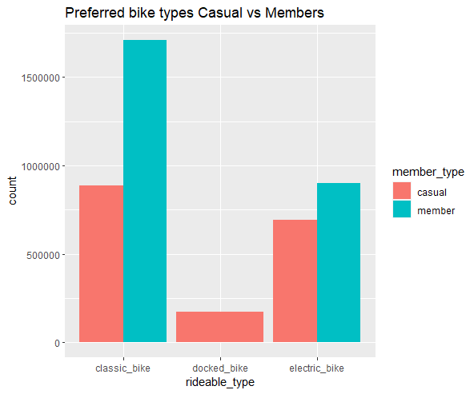
Types of Bike Preferred
Classic bike preferred by Annual members.
Casual members have no clear preference.

Slide 15
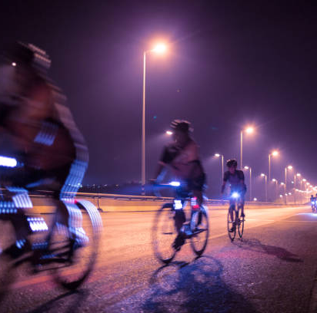
Recommendations
Special prices for weekends and in summer
Discounted overall annual membership price compared to individual rides
Targeted advertising towards younger individuals
Health based advertising campaigns at the start of the year

Slide 16
Questions?

Slide 17
The End

